Slide 1
Metadata
OLAC 2012-10-18??
Robert Olendorf & Zoe Chao

Slide 2
Outline
Metadata
Descriptive
Administrative
XML and RDF
MIA (metadata in action)
OAIPMH
Web search
Hands on exercise (METS)

Slide 3

The Problem
FIND
IDENTIFY
SELECT
OBTAIN
Notes:
In the FRBR Final report the committee identified these four primary use cases.
FIND Material based on the user’s search criteria
IDENTIFY the desired entity
SELECT the appropriate entity
OBTAIN gain access to the desired entity

Slide 4
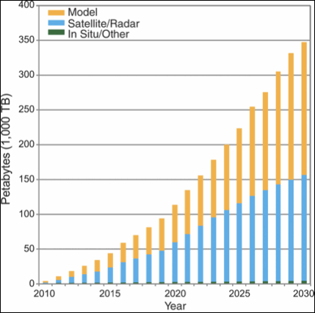
The Problem
FIND
IDENTIFY
SELECT
OBTAIN
Notes:
In the FRBR Final report the committee identified these four primary use cases.
FIND Material based on the user’s search criteria
IDENTIFY the desired entity
SELECT the appropriate entity
OBTAIN gain access to the desired entity

Slide 5
The Problem
Carmen – The Ballet
Carmen – The Score
Carmen – On Ice
Carmen – 1983 Movie
Notes:
The Ballet Carmen can be seen on video, in live performances. You can listen to the score. There is also Carmen On Ice and at least one move based on the ballet.

Slide 6

What Is Metadata
Metadata is in part a solution to these problems.

Slide 7
Function Requirement of Bibliographic Records
A Theory of Metadata

Slide 8
Works
Notes:
Work is a distinct intellectual creation – the concept of Carmen
Expression is a realization of that work – A ballet, the music, translations of a text
Manifestation is a physical embodiment – A companies version of the ballet, or an arrangement of the score. A movie.
Item – Deals with copies, such as individual CDs of the score.

Slide 9
Agents

Slide 10
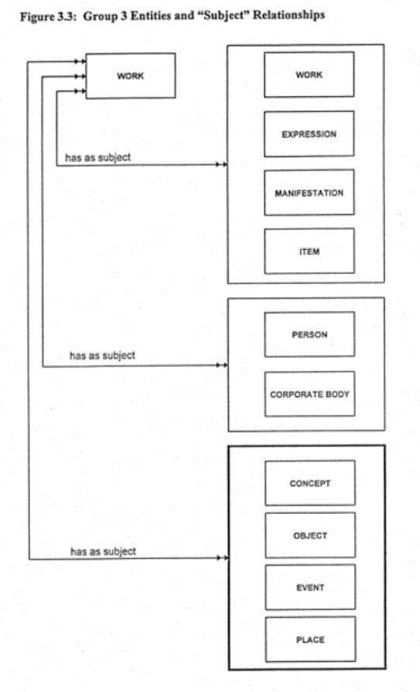
Subjects

Slide 11
Sample Work Attributes
title of the work
form of work
date of the work
other distinguishing characteristic
intended termination
intended audience
context for the work
medium of performance (musical work)
numeric designation (musical work)
key (musical work)
coordinates (cartographic work)
equinox (cartographic work)

Slide 12
Sample Expression Attributes
title of the expression
form of expression
date of expression
language of expression
other distinguishing characteristic
extensibility of expression
revisability of expression
extent of the expression
summarization of content
context for the expression
critical response to the expressionuse restrictions on the expression
sequencing pattern (serial)
expected regularity of issue (serial)
expected frequency of issue (serial)
type of score (musical notation)
medium of performance (musical notation or recorded sound)
scale (cartographic image/object)
projection (cartographic image/object)
presentation technique (cartographic image/object)
representation of relief (cartographic image/object)
geodetic, grid, and vertical measurement (cartographic image/object)
recording technique (remote sensing image)
special characteristic (remote sensing image)
technique (graphic or projected image)

Slide 13
Sample Manifestation Attributes
title of the manifestation
statement of responsibility
edition/issue designation
place of publication/distribution
publisher/distributor
date of publication/distribution
fabricator/manufacturer
series statement
form of carrier
extent of the carrier
physical medium
capture mode
dimensions of the carrier
manifestation identifier
source for acquisition/access authorization
terms of availability
access restrictions on the manifestation
typeface (printed book)
type size (printed book)
foliation (hand-printed book)
collation (hand-printed book)
publication status (serial)
numbering (serial)
playing speed (sound recording)
groove width (sound recording)
kind of cutting (sound recording)
tape configuration (sound recording)
kind of sound (sound recording)
special reproduction characteristic (sound recording)
colour (image)
reduction ratio (microform)
polarity (microform or visual projection)
generation (microform or visual projection)
presentation format (visual projection)
system requirements (electronic resource)
file characteristics (electronic resource)
mode of access (remote access electronic resource)
access address (remote access electronic resource)

Slide 14
Sample Item Attributes
item identifier
fingerprint
provenance of the item
marks/inscriptions
exhibition history
condition of the item
treatment history
scheduled treatment
access restrictions on the item

Slide 15
What FRBR Buys Us
An explicit relationship between entities
A mechanism for determining what attributes are required
A common language
A framework for extension and schema creation

Slide 16
Exercise
Develop a metadata record using FRBR for the given objects.

Slide 17
What is metadata?
Does it have to be….
in XML?
in the Web environment?
machine readable?
for electronic resources only?

Slide 18
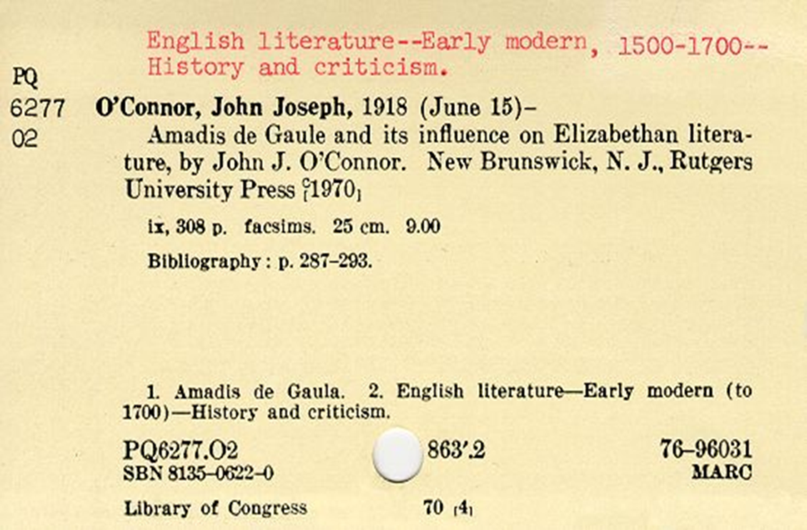
Is this metadata?

Slide 19
Metadata is…
Metadata is essential in providing the means to describe, share, search, manage and preserve (and understand - RO) our digital resources, ensuring maximum potential for use and re-use throughout their lifecycle. The selection of metadata, and its management and administration, should be tailored to meet the specific needs of the collection and its various users, and follow established best practice, where it exists, within the community in which you are working. While metadata should be created focusing on the resource at hand, ideally some thought should also be made towards making it possible to share your data with other collections, catalogues and systems to maximise the potential use and re-use of resources.

Slide 20
Metadata is…
data about data.
to impose some order in a disordered information universe. (Carl Lagoze)
constructed, constructive, and actionable. (Karen Coyle)

Slide 21
Metadata is…
“structured information that describes, explains, locates, or otherwise makes it easier to retrieve, use, or manage an information resource.”
NISO (2004). Understanding Metadata.
http://www.niso.org/standards/resources/UnderstandingMetadata.pdf
“structured, encoded data that describe characteristics of information-bearing entities to aid in the identification, discovery, assessment, and management of the described entities.”
ALA Committee on Cataloging: Description and Access

Slide 22
Boil down…
Structured data
Facilitate some types of actions
Find, identify, select, and obtain (FRBR)
Organization & management
The difference between data, metadata, and meta-metadata is often one of perspective. (Jenn Riley)

Slide 23

http://youtu.be/2wNTIPaBbPI

Slide 24
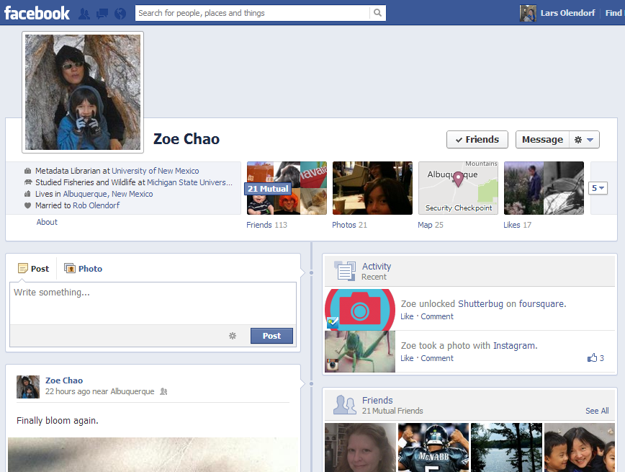

Slide 25
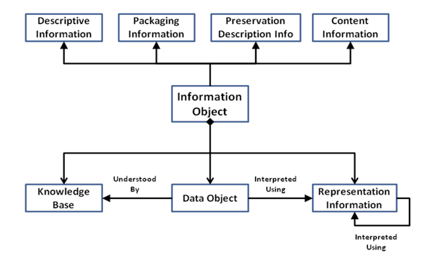
Open Archive Information Systems Metadata Ontology

Slide 26
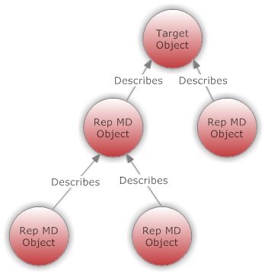
Representation Metadata
The “represenational network” can get big
Stopping rules?

Slide 27
Descriptive Metadata
Identifies a resource and describes its intellectual content
Title, author, keywords…
MARC, DC, EAD…
To find, access and manage

Slide 28
Technical Metadata
focuses on how a digital object was created
format, identifier, date…
MIX, NISO Z39.87, TextMD…
Use: manage, access

Slide 29
Preservation Provenance Metadata
contains information needed to archive and preserve a resource
Provides a history of ownership and changes
OAIS, PREMIS

Slide 30
Rights Metadata
Specifies intellectual property rights and permissions
CopyrightMD,
Creative Commons
Apache Software License
GNU GPL

Slide 31
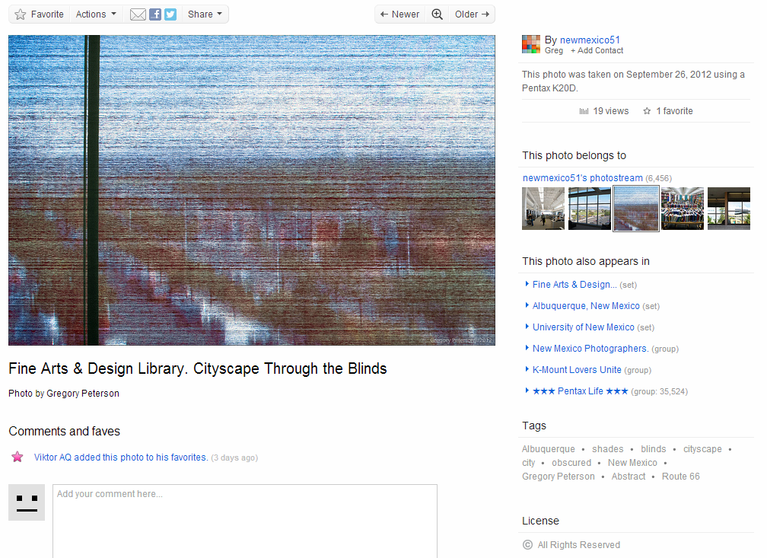
http://www.flickr.com/photos/8601342@N03/8031470074/in/photostream

Slide 32

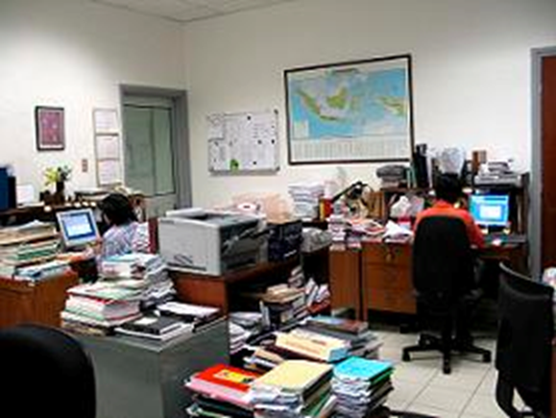
Who Creates Metadata?

Slide 33
Syntax vs. Semantic

Slide 34
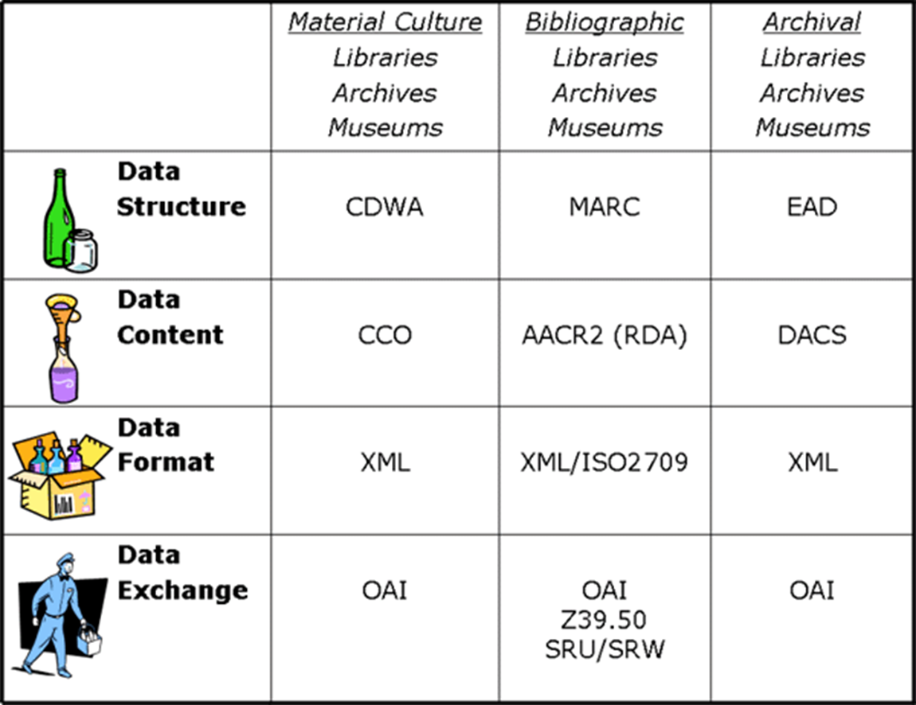
From “Metadata for All” by Elings & Waibel. <http://firstmonday.org/htbin/cgiwrap/bin/ojs/index.php/fm/article/view/1628/1543>
Notes:
CCO: cataloging cultural objects

Slide 35
How to structure?
Syntax: XML
Semantic: Metadata scheme
Semantic: Controlled vocabulary

Slide 36
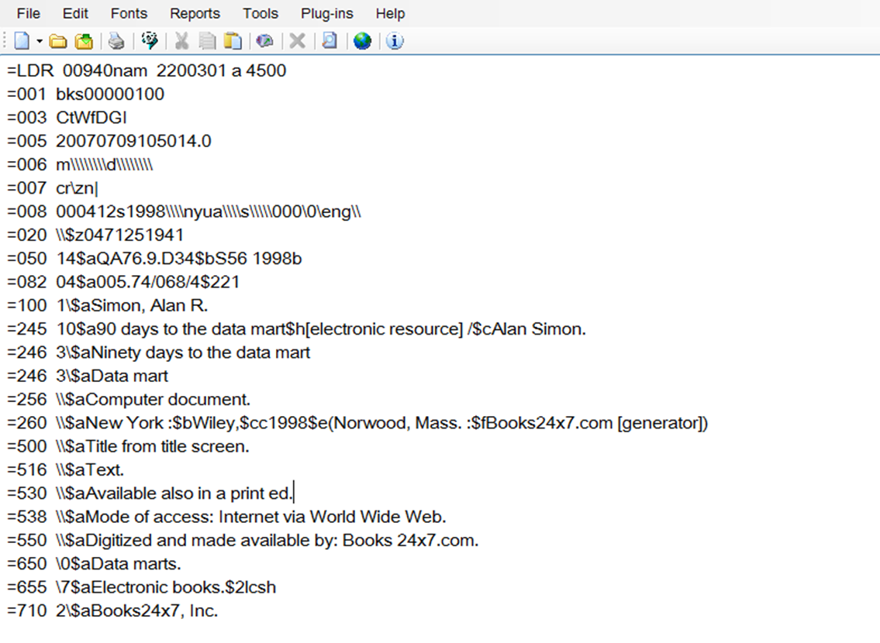
MARC

Slide 38
What is XML?
Why do we need markup?

Slide 39
Advantages of XML
Simple to understand and constructu
Universal
Both human and machine readable
Easy to transform

Slide 40
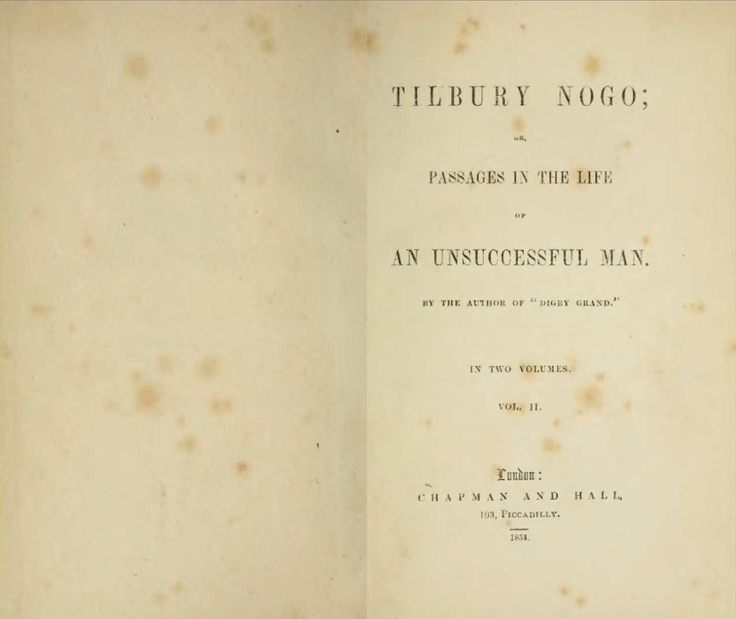

Slide 41
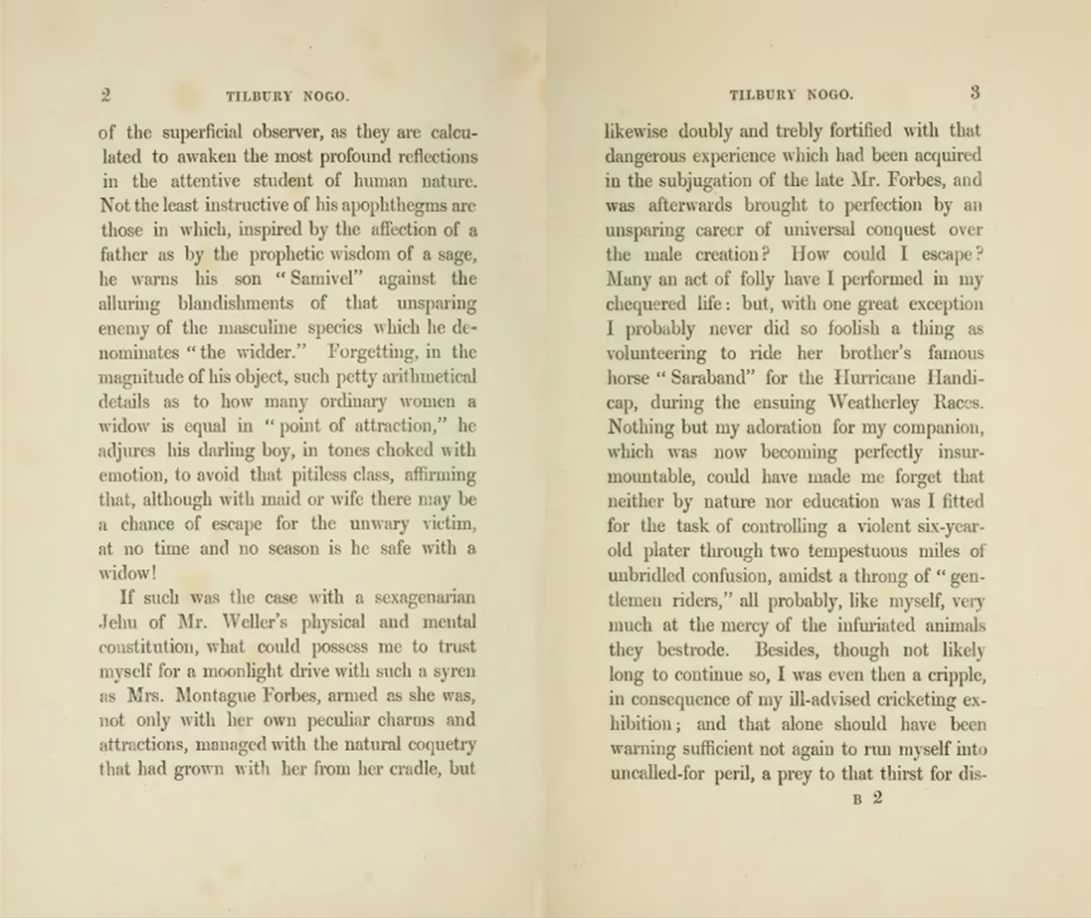

Slide 42
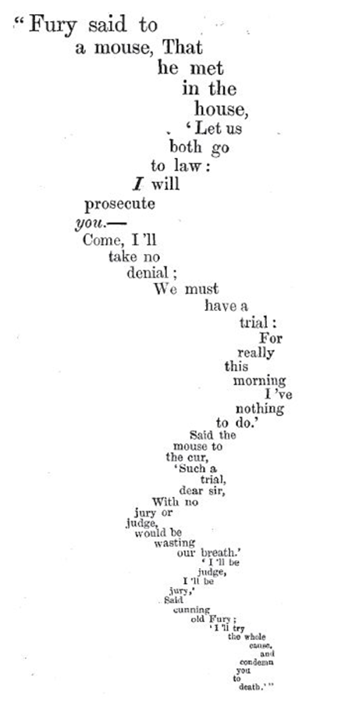
Lewis Carroll: The Mouse’s Tale

Slide 43
Syntax: how you say things
I love balloon fiesta!
Semantic: what it means
I love balloon fiesta!

Slide 45
What schema to use?
Simple schema (DC):
Complex schema
Application profile (mix and match)

Slide 46
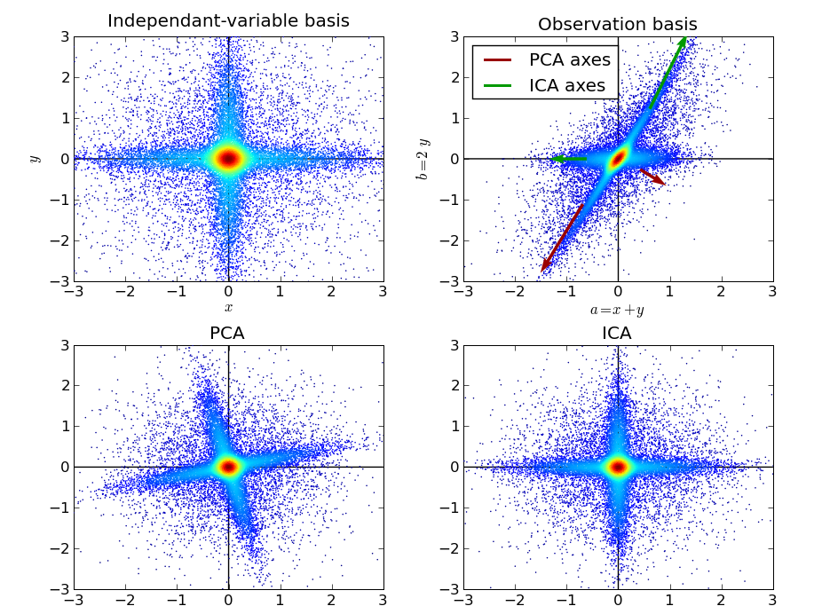
Another Problem

Slide 47
Hands on exercise

